Slide 1
Knowledge Triangle for a Low Carbon Economy KALCEA 618109 – EPP-1-2020-1-EL-EPPKA2-CBHE-JP
15.11.2020 – 14.11.2023
Report on the current situation of the knowledge triangle in each HEI
Mrs. Klarida Prendi
30.04.2021

Slide 2
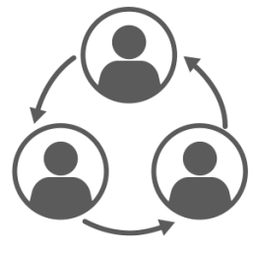
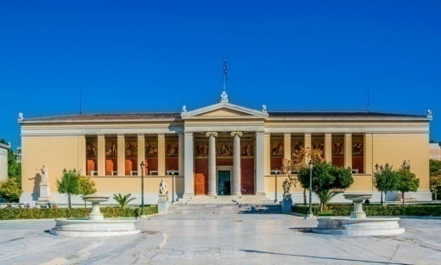
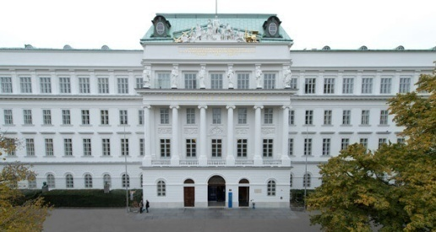
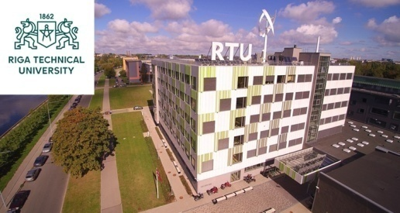
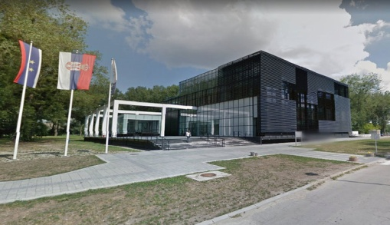
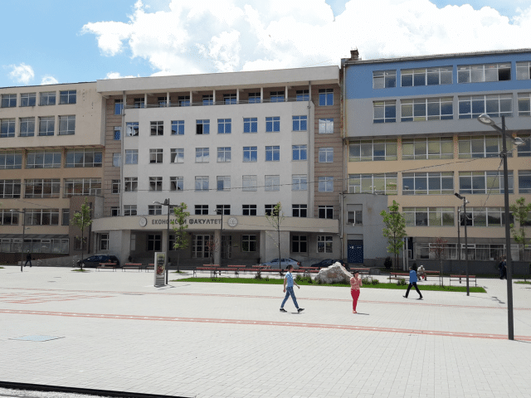
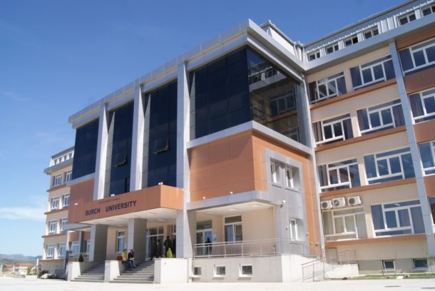
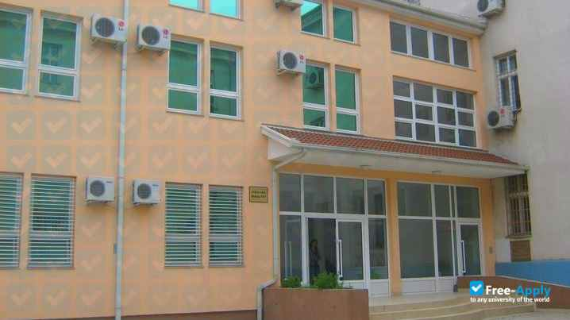
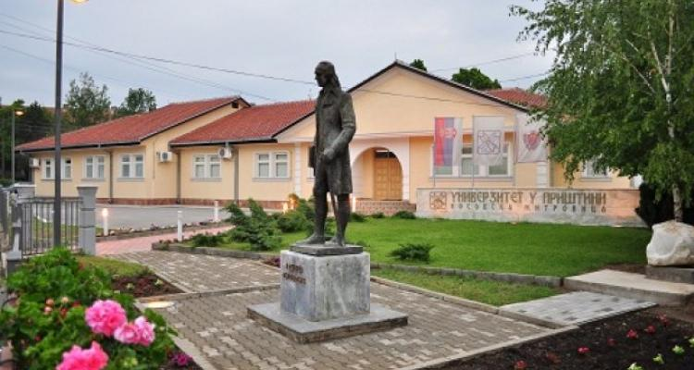
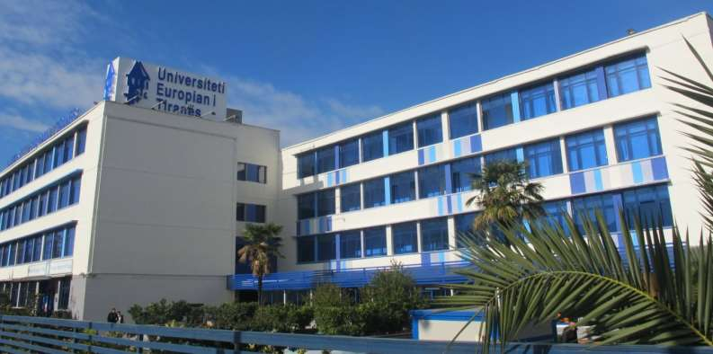
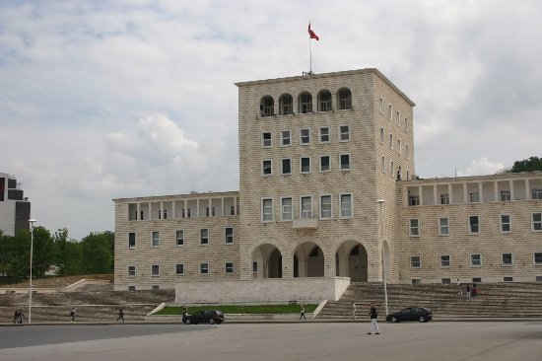
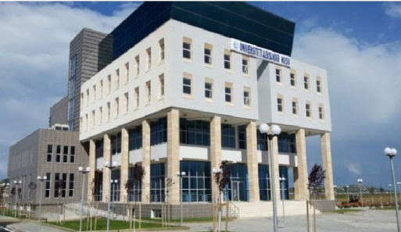
Konsortium
PARTNERS:
P1- Ethniko & Kapodistriako Panepistimio Athinon [NKUA]- Lider;
P2-Vienna University Of Technology (TU WIEN);
P3-Riga Technical University – RTU;
P4-University Of Novi Sad –UNS;
P5-Creative Thinking Development – CRETHIDEV;
P6-University Of East Sarajevo – UES;
P7-International Burch University – IBU;
P8-University Of Dzemal Bijedic Mostar - UDBM;
P9-Albenecon;
P10-University Of Pristina In Kosovska Mitrovica - UPKM;
P11-Universum College - UC;
P12-European University Of Tirana – EUT;
P13-Polytechnic University Of Tirana – PUT;
P14-Aleksandër Moisiu University Durrës (UAMD);
P15-Kompanija Zd Irce A.D. Istocno Sarajevo.

Slide 3
Main Objective:
The wider project objective is to create a systematic and structural approach for implementation of knowledge triangle principles, including sharing of knowledge, information and skills for joint exploitation of research capacities for sustainable growth based on innovation in WBC. The purpose is to create institutional integration of education, research and innovation.

Slide 4
Specific Project Objective/s:
To create a structured multi-country network between the HEIs and industry sector in WBC countries with aims to exploit the full value of collaboration and cooperation (open innovation), making an impact to academia, business and society.
To set-up 5 Knowledge - Innovation Centres at WBC in HEIs with aim to manage knowledge triangle activities in WBC, supported by the innovative cooperation platform.
To create and implement professional programme in cooperation with industry sector in the field of Sustainable energy in 3 WBC with HEIs involved.
To increase awareness on knowledge triangle importance in Albania, Bosnia and Kosovo.

Slide 5
Expected tangible results from the project in HEIs?
In general, all institutions will achieve the following:
1. Build strategic partnerships with industry sector and other external stakeholders. More than 60 institutions will be involved in the Regional network;
2. Develop open innovation platform based on cooperation between HEIs and industry sector;
3. Promote the role of the creative economy based on innovation and research in developing society;
5. Enable lifelong learning through professional and executive education services;
6. Contributing to the positive development of society at large.

Slide 6
Workpackages:
KALCEA
WP3
WP4
WP5
WP2
DEVELOPMENT
DEVELOPMENT
DEVELOPMENT
QUALITY PLAN
WP6
WP7
DISSEMINATION & EXPLOITATION
MANAGEMENT
WP1
PREPARATION

Slide 7
KALCEA
PREPARATION
WP1
The aim of this WP is to analyze the current situation in knowledge triangle (education, research and innovation) at HEIs in WBC countries.
Working teams will be created in each participating partner country institutions.
Estimated Duration Date: 15-12-2020: 15-07-2021
Lead-University of Novi Sad, co-lead -Aleksandër Moisiu University Durrës.

Slide 8
KALCEA
DEVELOPMENT
WP2
Networking between higher education & research institutions and industrial/business stakeholders.
Estimated Duration Date:
15-03-2021: 14-11-2023
Lead-University of Dzemal Bijedic Mostar, co-lead- Polytechnic University of Tirana.

Slide 9
KALCEA
DEVELOPMENT
WP3
Creation of Knowledge-Innovation Centers(KIC)at WBC universities;
Two centers will be created in B&H, One center will be created in Albania (UET) and Two Centers will be created in Kosovo;
One of the roles of those centers will be to create interaction between academia, research institutions and industry sector at national and regional level in cooperation and support of all HEIs involved in the application.
Estimated Duration Date: 15-09-2021:14-11-2023
Lead – International BURCH University,
co-lead- Vienna University of Technology.

Slide 10
KALCEA
DEVELOPMENT
WP4
Development and implementation of professional programme in Sustainable Energy and Innovation.
One workshop will be organized at the University of East Sarajevo.
Estimated Duration Date:
15/12/2021: 14/11/2023
Lead- Riga Technical University,
co-lead- University of East Sarajevo.

Slide 11
KALCEA
QUALITY PLAN
WP5
This WP is dedicated to the quality assurance and monitoring of the project implementation and its outcomes, according to the ENQA guidelines.
Estimated Duration Date:
15-11-2020: 14-11-2023
Lead-Creative Thinking Development,
Co-lead-University of Pristina in Kosovska Mitrovica.

Slide 12
KALCEA
DISSEMINATION & EXPLOITATION
WP6
The WP will cover internal and external dissemination performed by WB and EU partners respectively.
The aim of dissemination is to:
1) increase public awareness about the project and its impact and;
2) motivate academic staff, professionals, industry sector, researches to increase cooperation between academia and industry, with aim to increase impacts of a working knowledge triangle on society.
Estimated Duration Date: 15-11-2020: 14/11/2023
Lead- European University of Tirana,
Co-lead- Universum College.

Slide 13
KALCEA
MANAGEMENT
WP7
The aim of this WP is to manage and coordinate the activities of the project effectively and efficiently.
Estimated Duration Date:
15/11/2020: 14/11/2023
Lead- Ethniko & Kapodistriako Panepistimio Athinon ,
co-lead- International BURCH University.

Slide 14
WP1: PREPARATION
Tasks:
D.1.1. Best practices on the knowledge triangle in EU institutions;
D.1.2. Survey on the current situation of cooperation between HEIs and the business sector;
D.1.3. Report on the current situation of the knowledge triangle in each HEI of partner countries;
D.1.4. Recommendations from EU experts on further steps for the development of knowledge triangle activities.

Slide 15
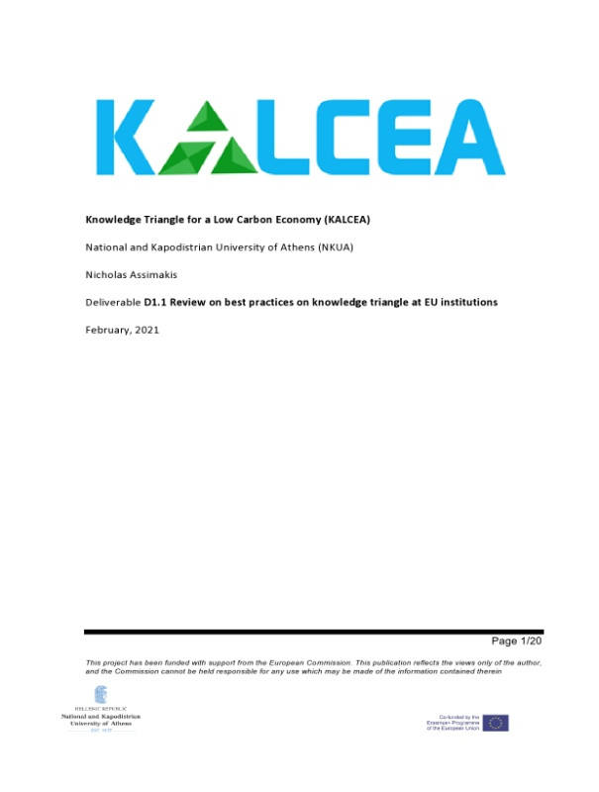
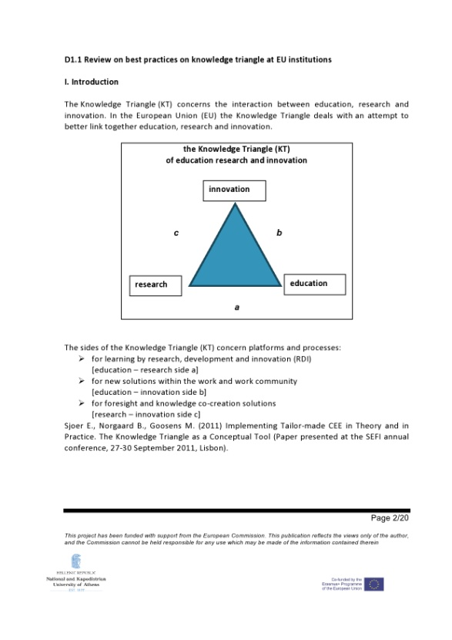
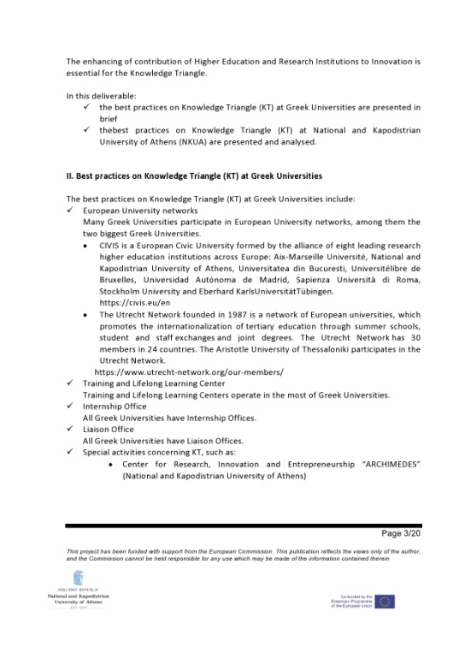
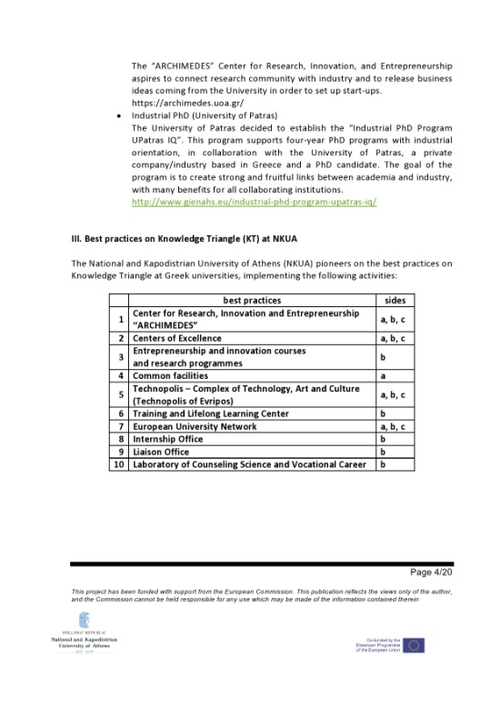
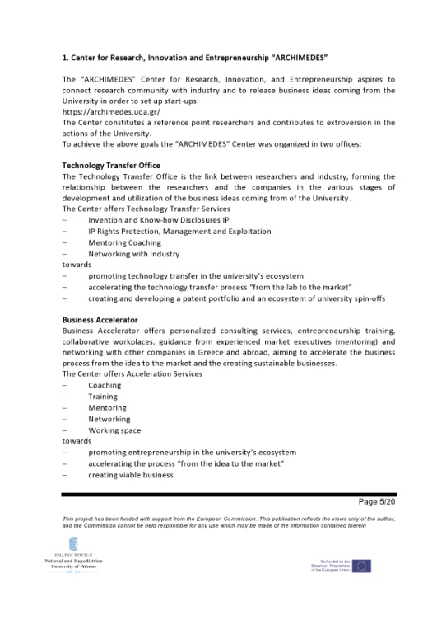
D.1.1. Best practices on the knowledge triangle in EU institutions
In this task:
Knowledge Triangle (TC) best practices in Greek Universities;
Best practices Triangle of Knowledge (CT) at the National University of Kapodistriako in Athens.

Slide 16
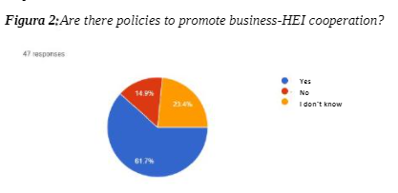
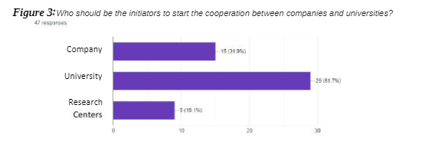
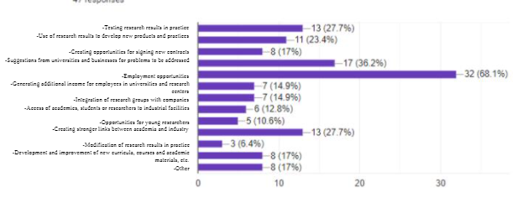
D.1.2. Survey on the current situation of cooperation between HEIs and the business sector

Slide 17
D.1.3. Report on the current situation of the knowledge triangle in each HEI of partner countries.

Slide 18
Thank you for your attention!

